Slide 1

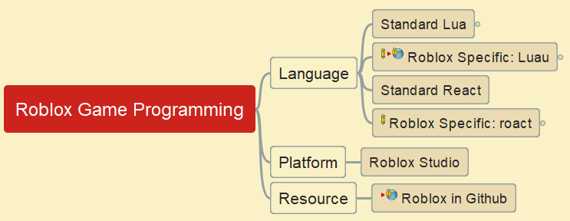
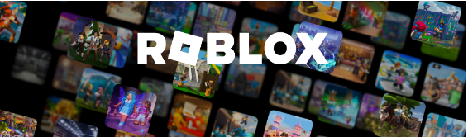
Roblox Gaming Programming
https://github.com/yasenstar/roblox_luau_lua

Slide 2


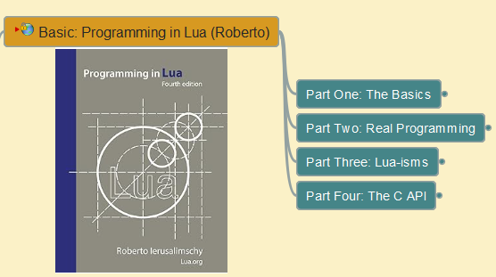
Lua Programming Tutorial
001 – Install and Make Lua Working in Windows OS
Based on Book “Programming in Lua”

Slide 3
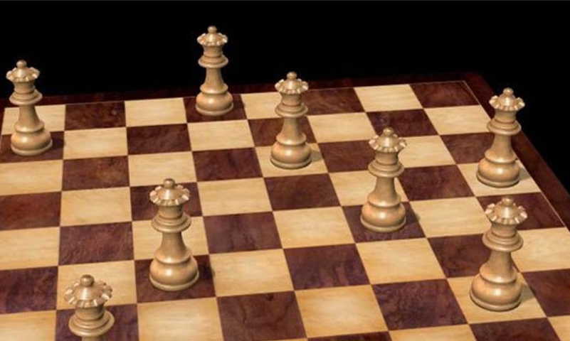
Lua Programming Tutorial
002 – Eight Queen Puzzle
Based on Book “Programming in Lua”

Slide 4
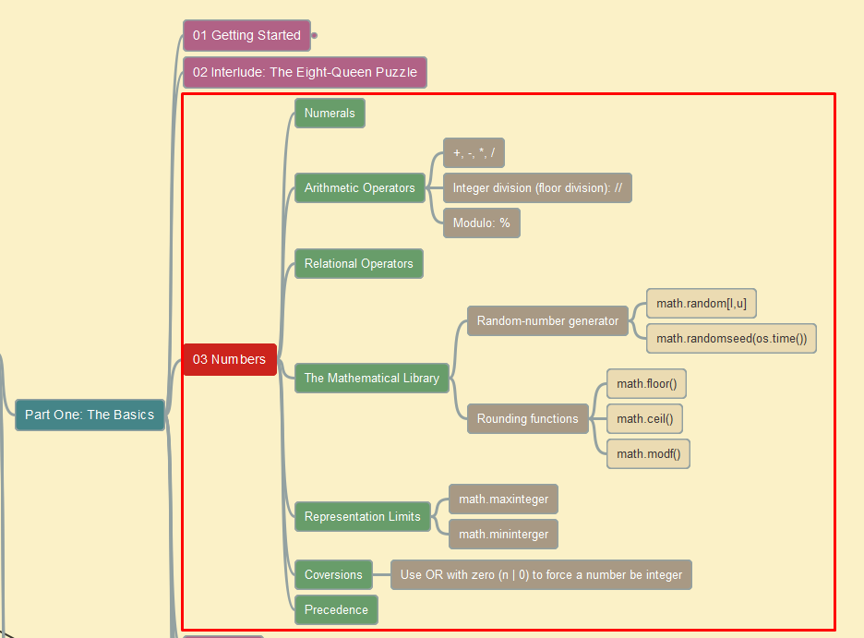
Lua Programming Tutorial
003 – Numbers in Lua
Based on Book “Programming in Lua”

Slide 5
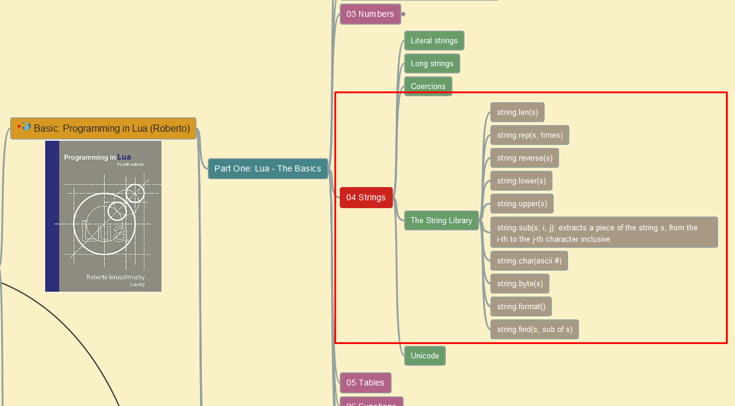
Lua Programming Tutorial
004 – Strings in Lua
Based on Book “Programming in Lua”

Slide 6


